Slide 1

Alex Perkins Homepage
Project 1: Web Development Course Northeastern University

Slide 2
Objectives
Project Description
To implement static homepage using HTML5, CSS3 and ES6+ and with no backend or any components libraries to be used. Not using jQuery and all JS code are in ES6 modules.
Homepage for Alex Perkins to include brief background, projects, and contact information as way for recruiters, professors, classmates, and any colleagues or other professionals to visit for introduction.

Slide 3
User Personas
Recruiters
those looking for summary of skills and achievements with visibility into projects, access to GitHub and Linkedin, and contact information
Professors, Classmates
those looking to learn about Alex’s background and relevant experience or coursework
Colleagues, other Professionals
those looking to connect or share experiences

Slide 4
User Stories
Recruiters
reviewing candidates for role and finds Alex’s Linkedin profile. Decides to click on homepage to learn more about his background and projects to determine if it matches with client’s needs before reaching out.
Professors, Classmates
reviews Alex’s homepage to see the webpages meet criteria of coursework and verify abilities with course progression.
Colleagues, other Professionals
sees mutual connection on Linkedin or meets Alex at networking event. Visits homepage to understand Alex’s background and consider future opportunities together.

Slide 5
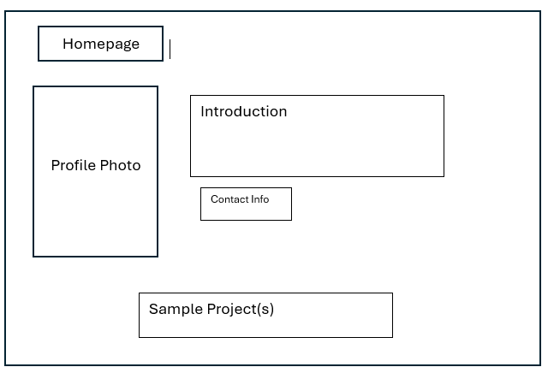
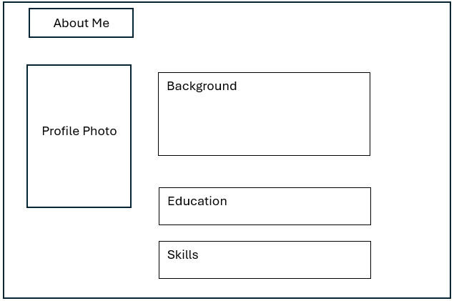
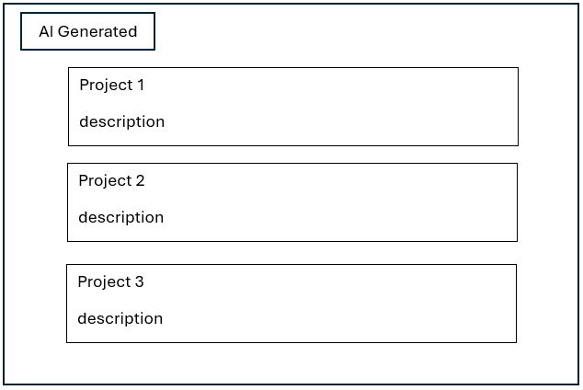
Design Mockups

Slide 6
Technology Used
VS Code
ESLint
Live Server
Prettier
Netlify
Claude Sonnet

Slide 7
What I’m Proud Of
Completing personalized web pages without much clutter and using it to represent some of my accomplishments
Including and adjusting images successfully whether it’s just to provide the alt images required or including some as background and knowing where edits need to be made between CSS and HTML

Slide 8
What I Struggled Most With
Initial proper set up for VS Code and extensions, making sure everything was working before actually starting and testing
Making multiple edits and deployments without much planning and trying to finalize resulted in running out of credits on Netlify and ultimately required me to pay for membership or start over elsewhere
Struggled implementing the typing animation to make homepage stand out so had to rely on AI for implementation support which I was then able to edit it
Ran out of time and didn’t plan adequate time to complete the assignment on due date

Slide 9
Demo
https://www.youtube.com/watch?v=agWw2XSS6fo

